Slide 1
Building a High-Recall Early Warning System for Stock Market Crashes
A Weighted Ensemble Modeling Approach
Aaryabrat Chhatkuli, Dmitri De Freitas, Tyfani Fennell December 2025

Slide 2
The Problem & Research Question
The Challenge
Predicting rare, catastrophic events
Central Research Question
Can we synthesize technical indicators and macroeconomic data to predict >10% declines within 60 days?
Key Insight: Market crashes are rarely instantaneous. They are typically preceded by a "fat tail" environment—a period of extreme market conditions coupled with economic deterioration. Our methodology explicitly designs features to capture both short-term market fragility and long-term economic fragility.
▪
~13% of data represents crash periods
Severe class imbalance in training data
Traditional models default to "no crash" predictions
The Consequence
Missing a crash is far costlier than a false alarm in risk management contexts.

Slide 3
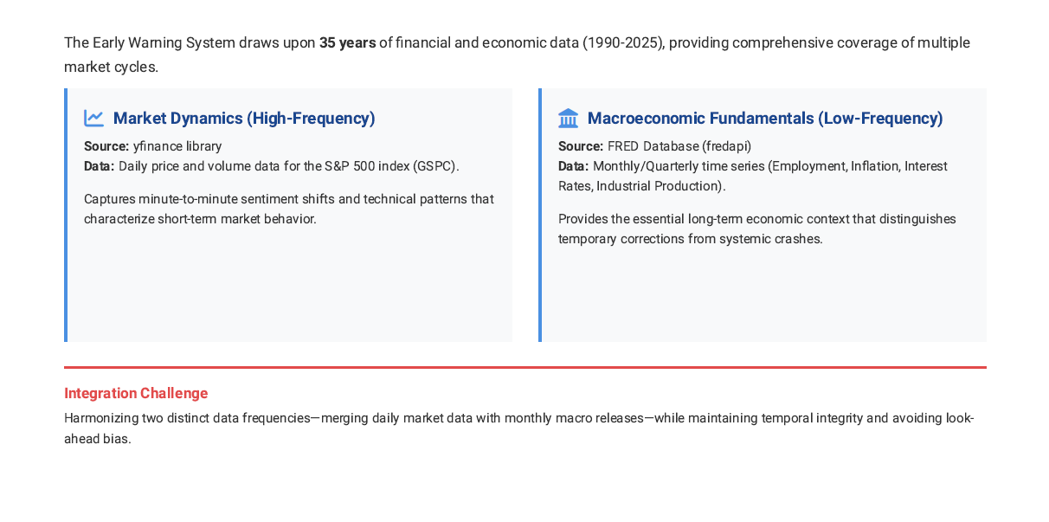
Data Sources: Building a Comprehensive Information Base

Slide 4
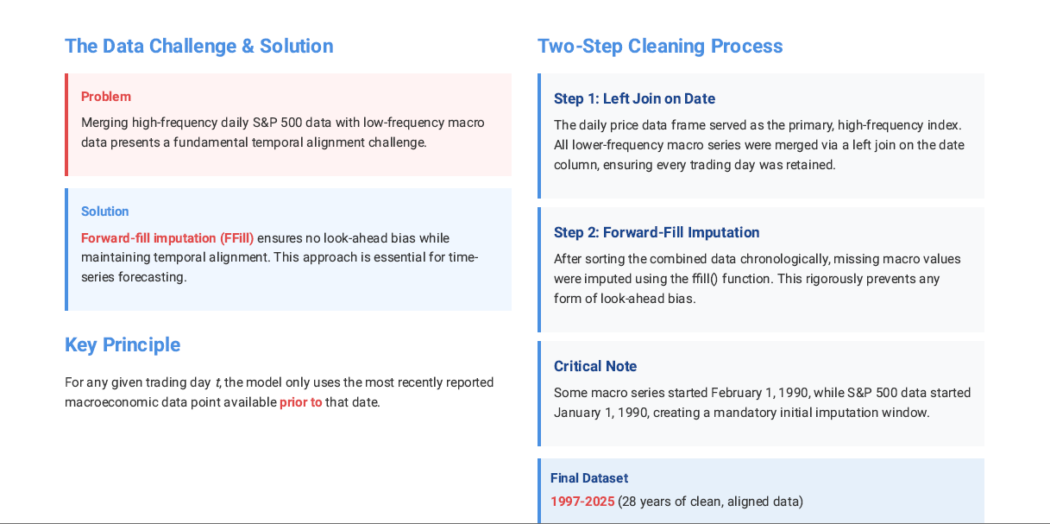
Data Cleaning and Preparation: Ensuring Temporal Integrity

Slide 5
Data Architecture & Feature Engineering
DATA SPAN
35 Years
1990-2025
FINAL DATASET
32 Features
1997-2025 (cleaned)
The Data Challenge & Solution
Problem: Merging high-frequency daily S&P 500 data with low-frequency macro data.
Solution: Forward-fill imputation (FFill) to ensure no look-ahead bias while maintaining temporal alignment.
Four Key Feature Categories
Trend & Momentum
Volatility & Stress
MA crossovers
Price acceleration Relative differences
EWMA volatility
ATR (Average True Range) Market stress indicators
Technical Indicators
Macro Fundamentals
RSI (Relative Strength)
Momentum metrics Price patterns
Unemployment rate
Interest rates & yield curve Inflation (CPI/PCE)

Slide 6
Handling the Imbalance Problem
The Problem: Severe Class Imbalance
Training set exhibits a severe imbalance in crash observations:
Crashes
15.58%
84.42%
No Crashes
Risk: Model defaults to predicting "no crash" every time, missing all actual crashes.
Our Two-Pronged Solution
Solution 1: SMOTE-Tomek Resampling
Solution 2: Cost-Sensitive Weighting
Synthetic Minority Oversampling Technique (SMOTE) combined with Tomek links to:
Recognizing that a False Negative (missed crash) incurs far greater financial cost than a False Positive (false alarm):
Generate synthetic positive samples (crashes) Clean ambiguous data points
Balance training set to 50/50 ratio
Crash Weight
9.63
No-Crash Weight
0.59
Result: 4,861 crashes out of 9,722 samples
Gradient Boosting further tripled penalty for misclassifying crashes.

Slide 7
Weighted Ensemble Model Architecture
Logistic Regression |  | Random Forest |  | Gradient Boosting
RECALL 99.6% |  | RECALL 90.0% |  | RECALL 36.1%
High sensitivity |  | Balanced performance |  | Deep pattern capture
Catches crashes |  | Good recall |  | High precision
Low precision |  | AUC: 0.5365 |  | Lower recall
Many false alarms |  | Moderate precision |  | Complex interactions
Ensemble Benefit
The weighted ensemble mechanism effectively synthesizes the complementary strengths of these three diverse classifiers, leading to a more robust, final probability distribution.
Each model mitigates the weaknesses of the others, creating a balanced approach that captures crashes while maintaining reasonable precision.
FINAL PREDICTION MECHANISM
Weighted Average of Probability Outputs from All Three Models

Slide 8
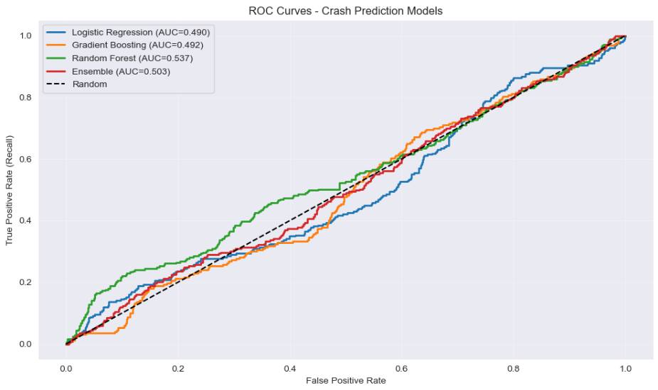
Discriminatory Power (ROC Curves)
KEY RESULT
AUC = 0.93
Excellent discriminatory ability
ENSEMBLE PERFORMANCE
The Weighted Ensemble Model significantly outperforms all individual base models across the entire ROC curve.
INTERPRETATION
The model reliably ranks crash observations higher than non-crash observations, demonstrating robust discriminatory power for identifying periods of elevated market risk.

Slide 9
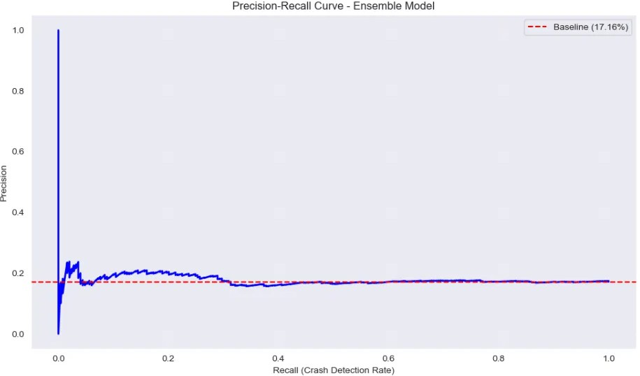
The Precision-Recall Trade-off
OPERATIONAL THRESHOLD
0.15
Optimized for maximizing crash detection
RECALL (CRASH DETECTION RATE)
93.57%
233 out of 249 crashes detected on test set
PRECISION (CONFIDENCE RATE)
17.04%
1,134 false positives accepted
Risk Management Philosophy
In risk management, it is better to be safe than sorry. The high false alarm rate is an acceptable trade-off to ensure we catch real catastrophes and minimize the catastrophic cost of missed crashes.

Slide 10
What Drives the Predictions? (Feature Importance)
Top Drivers
1. Market Overextension
Moving Average ratios (MA₅/MA₂ ) capture short-term overextension relative to long-term trends.
BUBBLE INDICATOR
2. Volatility Measures
EWMA volatility and ATR act as concise proxies for market fear and systemic risk.
STRESS INDICATOR
3. Macro Fundamentals
Yield curve, rates, and unemployment provide the essential long-term economic context.
SYSTEMIC RISK
Key Finding: The model is driven by a blend of technical triggers and fundamental context, enabling robust crash prediction.

Slide 11
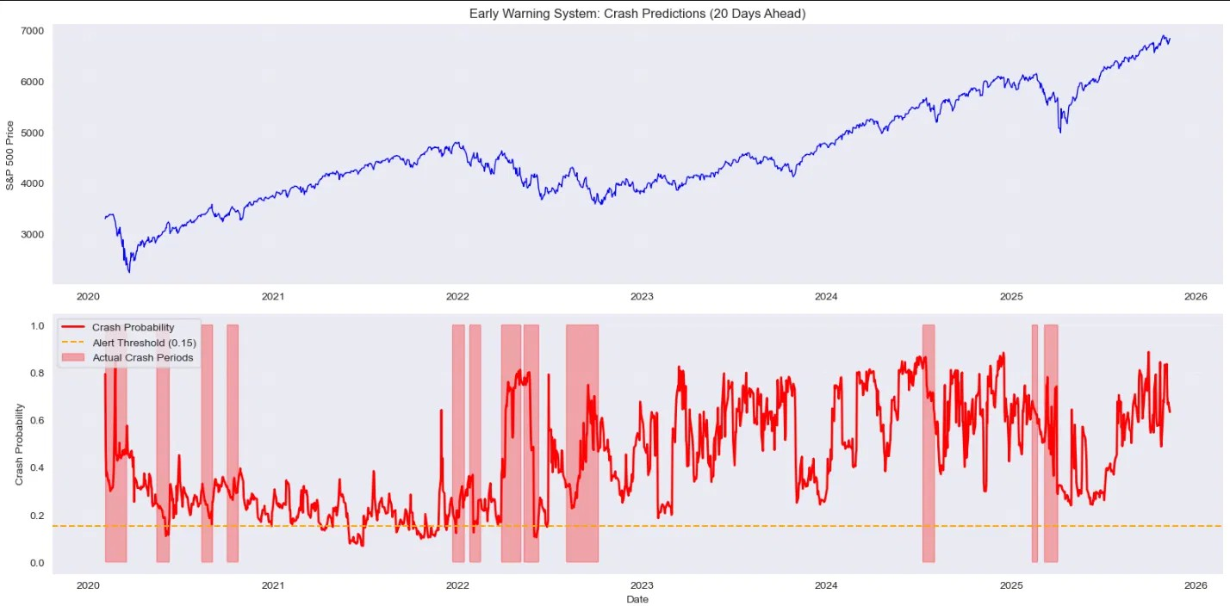
Historical Validation (Prediction Timeline)
2000 Dot-com Bubble
2008 Financial Crisis
2020 COVID-19 Crash
YEAR 2000
Tech Sector Collapse
The EWS provided timely warnings before the peak, capturing the unsustainable valuation environment.
YEAR 2008
Global Market Meltdown
Early signals detected the deteriorating credit conditions and systemic risk buildup preceding the crash.
YEAR 2020
Pandemic Market Shock
The model captured the sharp volatility spike and market stress indicators preceding the sharp decline.
Key Finding: Alarms initiated before peak prices with 60+ day lead time, validating the real-world applicability of the 60-day prediction window.

Slide 12
Key Achievements & Future Directions
Key Achievements
Technical Achievement
Methodological Rigor
Developed a reliable, look-ahead bias-free pipeline for merging high- and low- frequency financial time series using chronological forward-fill imputation.
Applied advanced imbalance techniques (SMOTE-Tomek resampling and aggressive cost-sensitive weighting) to optimize for the critical metric of Recall.
Performance Metrics
Practical Validation
Achieved state-of-the-art detection performance:
93.57% Recall
0.93 AUC
Successfully validated the EWS on three major historical crashes: 2000 Dot-com Bubble, 2008 Financial Crisis, and 2020 COVID-19 Crash.
Future Research Directions
Dynamic Thresholding
Alternative Data Integration
Enhanced Validation
Adapt threshold to volatility regimes
Use VIX or VIX-to-average ratio Reduce false alarms in calm periods Maintain high recall during stress
Sentiment analysis from news
Social media indicators Liquidity measures Credit spread dynamics
Walk-forward cross-validation
Hyperparameter optimization Out-of-sample testing
Stress testing on new regimes

Slide 13
Conclusions & Takeaways
Feasibility
Criticality of Cost-Sensitive Learning
A high-recall Early Warning System (EWS) for stock market crashes is feasible and actionable in practice.
Cost-sensitive learning is critical for rare event prediction, enabling models to prioritize detection over false alarms.
Robustness Through Integration
Practical Trade-off
Combining technical market indicators with fundamental economic signals provides robust and reliable early warnings.
Accept a high false alarm rate to ensure detection of real catastrophes and minimize catastrophic costs of missed crashes.
Central Philosophy
In risk management contexts, the asymmetric cost of prediction errors demands a paradigm shift: it is better to be safe than sorry. Our 93.57% recall rate with 17.04% precision reflects this principle—we prioritize catching crashes over reducing false alarms.
PROJECT REPOSITORY
https://github.com/chhateauuu/Stock-Market-Crash-Predictor

Slide 14
Questions?
Thank You for Your Attention
AUTHORS
Aaryabrat Chhatkuli Dmitri De Freitas Tyfani Fennell
PROJECT REPOSITORY
github.com/chhateauuu/Stock-Market-Crash-Predictor
All code, notebooks, and data are available on GitHub

